Slide 1
The History of Benches
By Emma Grace Mason

Slide 2
“The terms "bench" and "form" can be used interchangeably to refer to backless and elongated wooden seating. Originally a bench may have been freestanding and movable, whereas a form referred to a bench fixed to the wall. Furthermore, the term “bench” has acquired the additional meaning of a work surface, such as a cabinetmaker’s workbench.” Source: A Short History of Benches
by Graham Blackburn

Slide 3
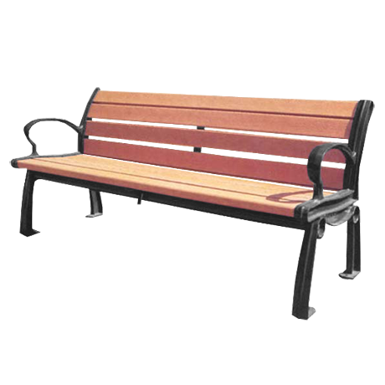
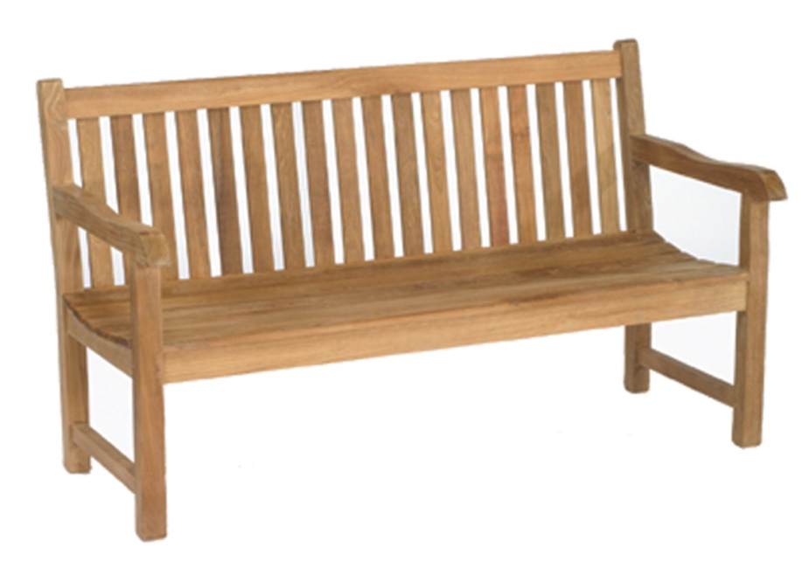
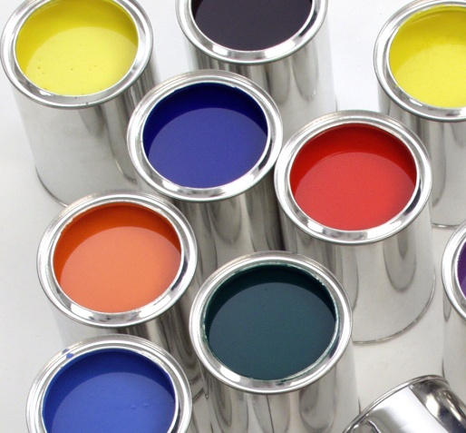
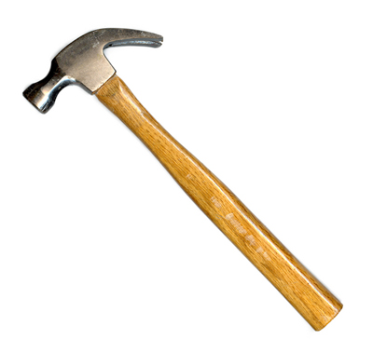
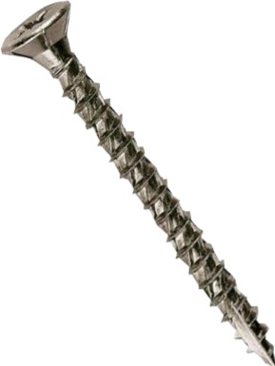
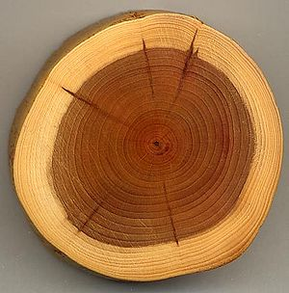
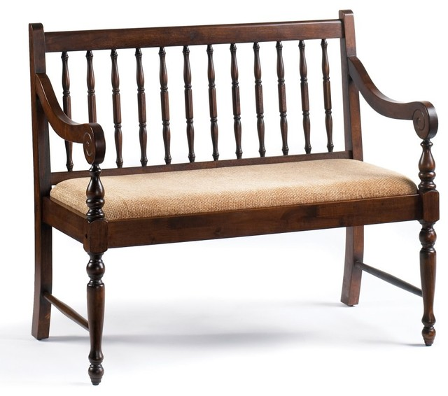
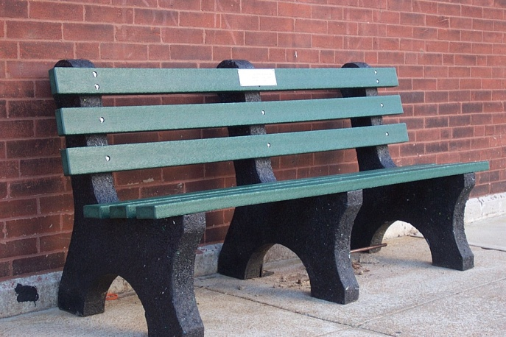
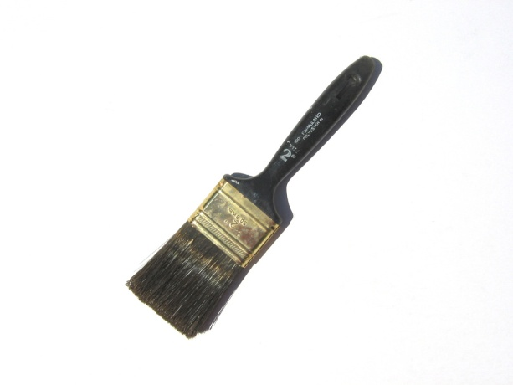

Slide 4
“The bench was the common seating form in the days when chairs were reserved for the most important people (hence the term "chairman"). Early types were very simple, consisting of a plank supported by solid ends connected by brackets or a stretcher.” Source: A Short History of Benches
by Graham Blackburn

Slide 5
Later developments included benches with joined legs, similar to an elongated joint stool. At a certain point the legs were extended up past the seat to form sides and a back.
Source: A Short History of Benches
by Graham Blackburn

Slide 6
At the other extreme are benches that are so long as to require additional support between the ends, like many cane-seated examples made in the 18th century.
Source: A Short History of Benches
by Graham Blackburn

Slide 7
Both benches and settles may also be thought of as extensions of chests, which were used for seating in the days before chairs became common. Both planked chests and frame-and-paneled chests are easily turned into settles by the simple extension upwards of either the sides or the legs.
Source: A Short History of Benches
by Graham Blackburn

Slide 8
While the elongation which separates a bench from a stool is generally intended to provide seating for more than one person, a notable exception is the piano bench, which sometimes differs from other benches in also often having an upholstered seat.
Source: A Short History of Benches
by Graham Blackburn

Slide 9
The benches were first made for the common people. Chairs were made for the more important people.

Slide 10
Benches are made of: wood stone metal synthetic materials

