Slide 1
Big Bill’s Geocaching Adventure
Class Book of Our Travel Bug Journey

Slide 5
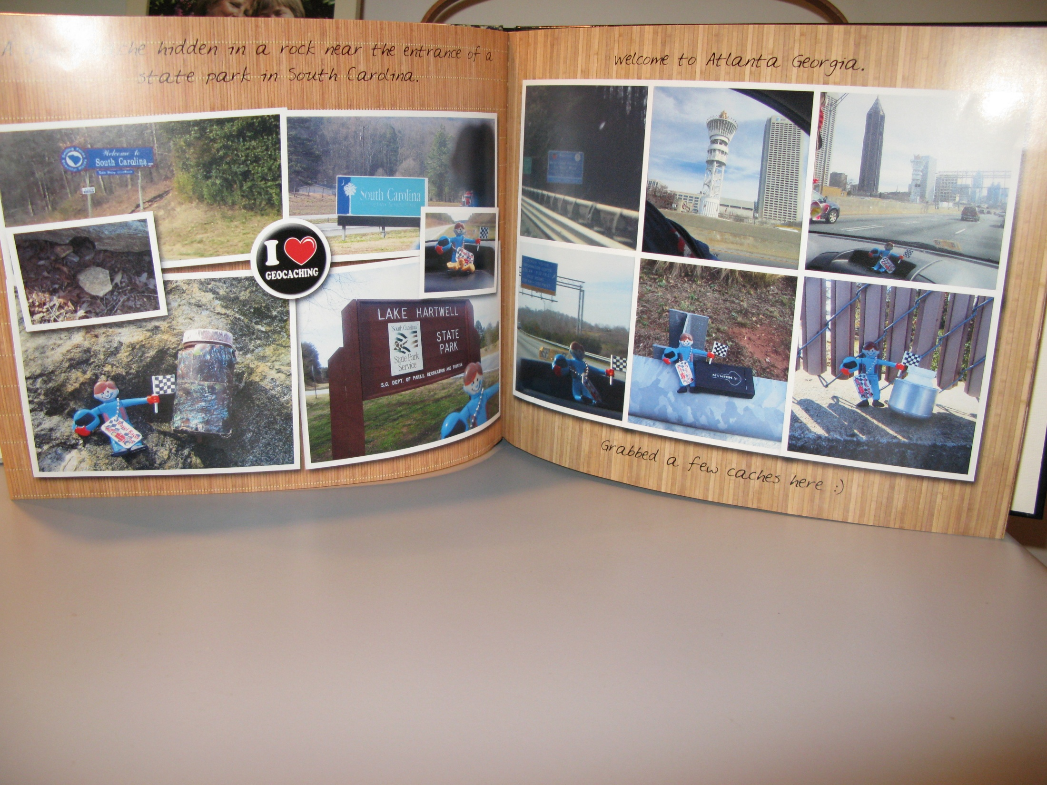

Slide 6
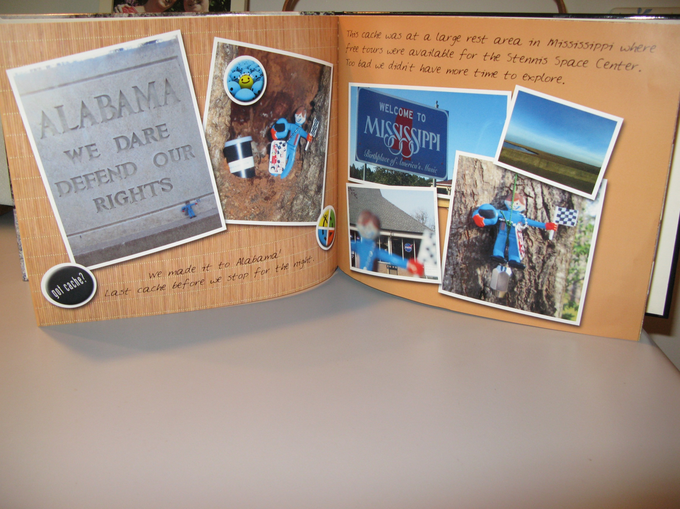

Slide 8
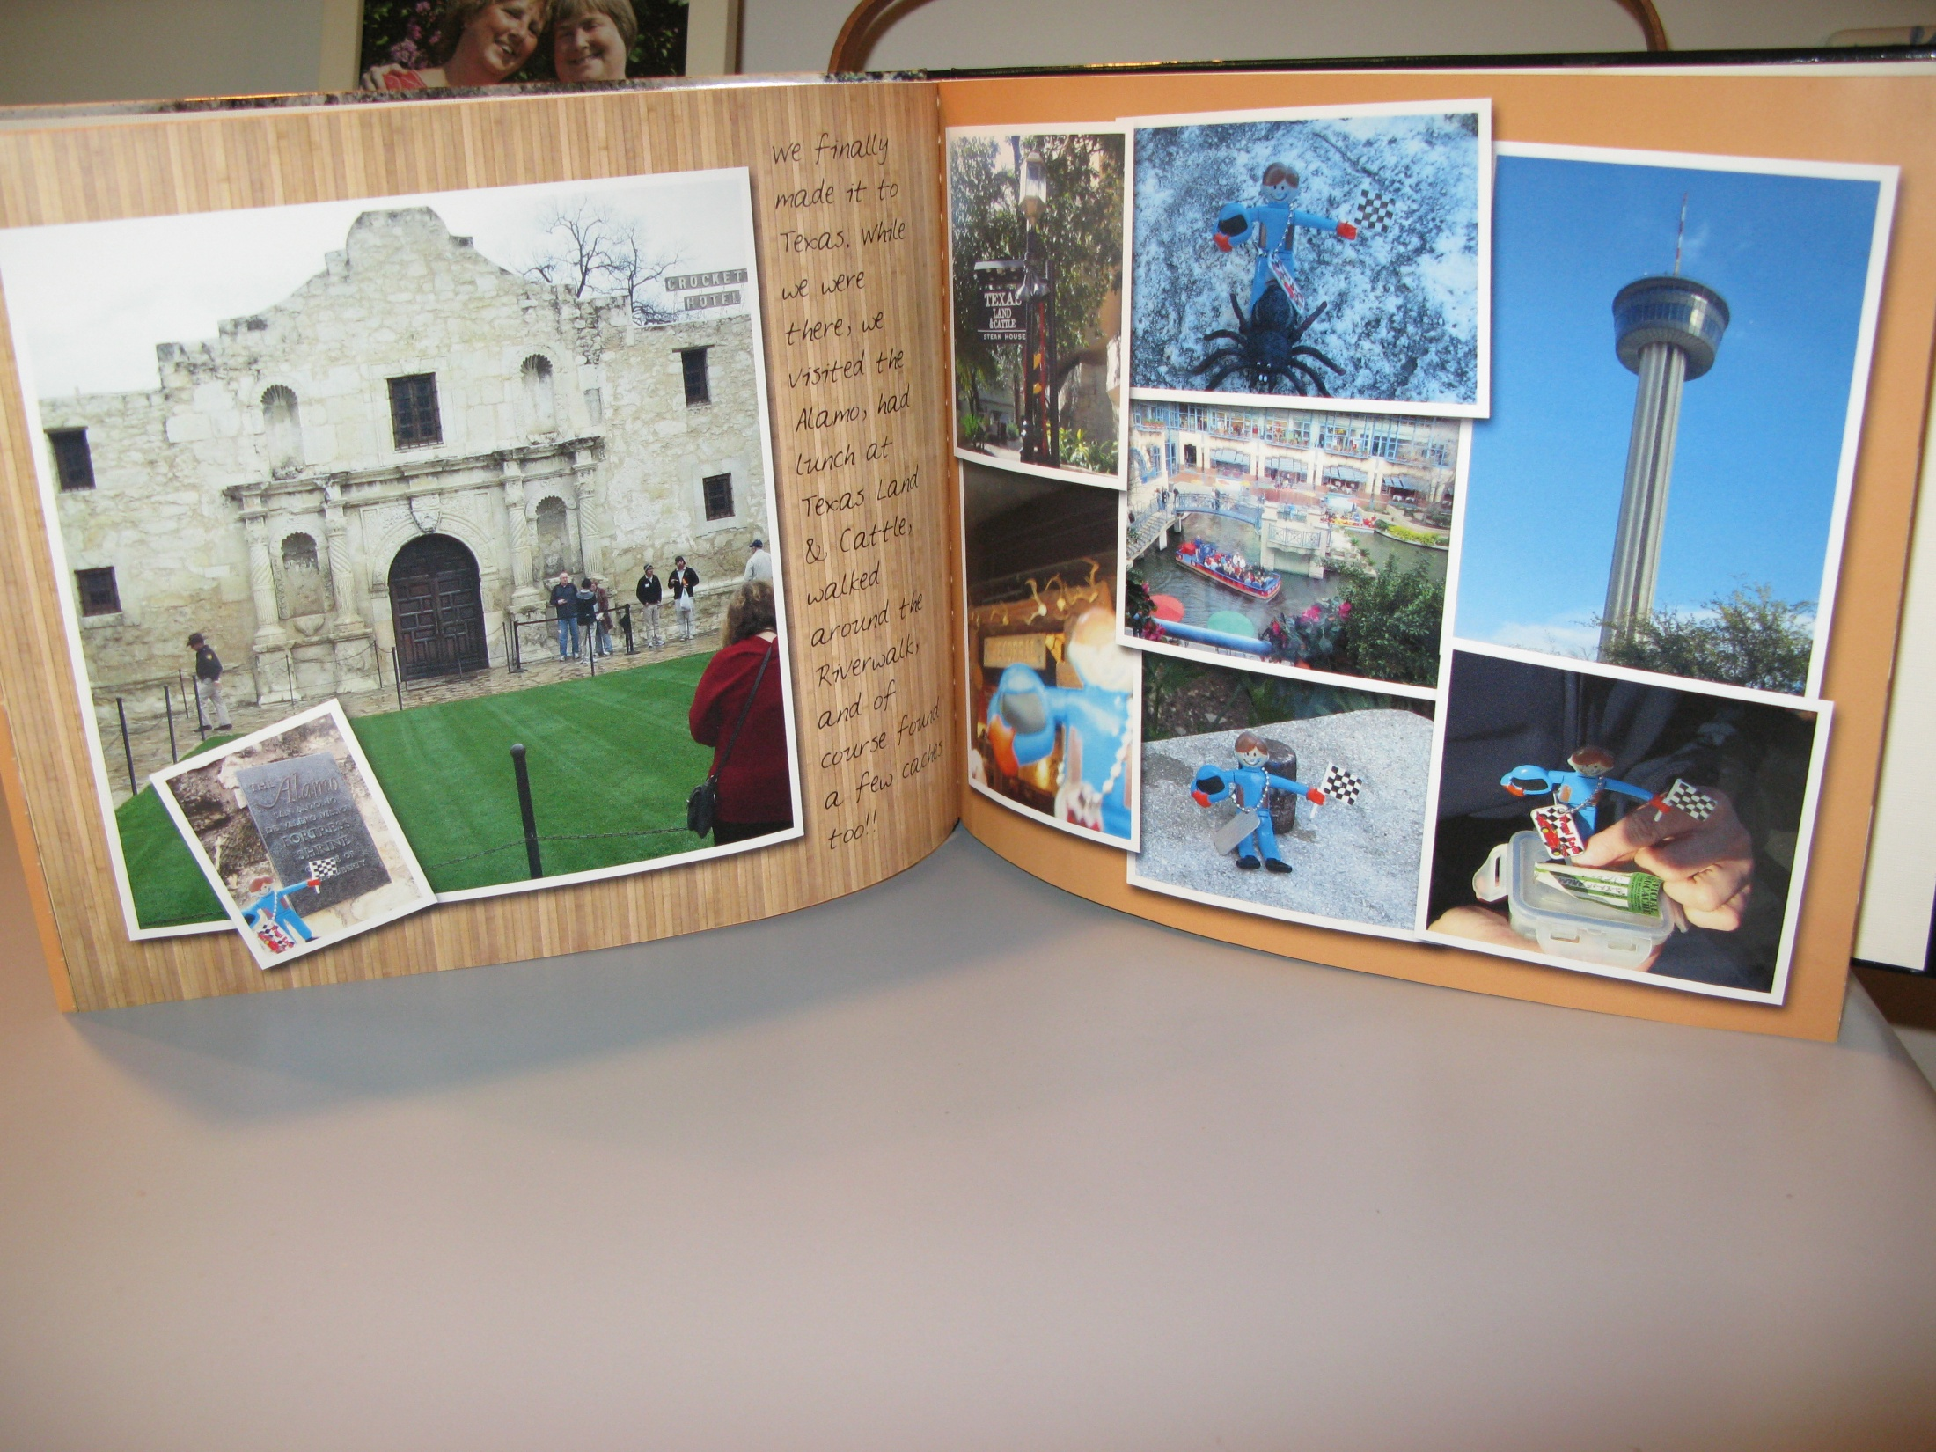

Slide 9
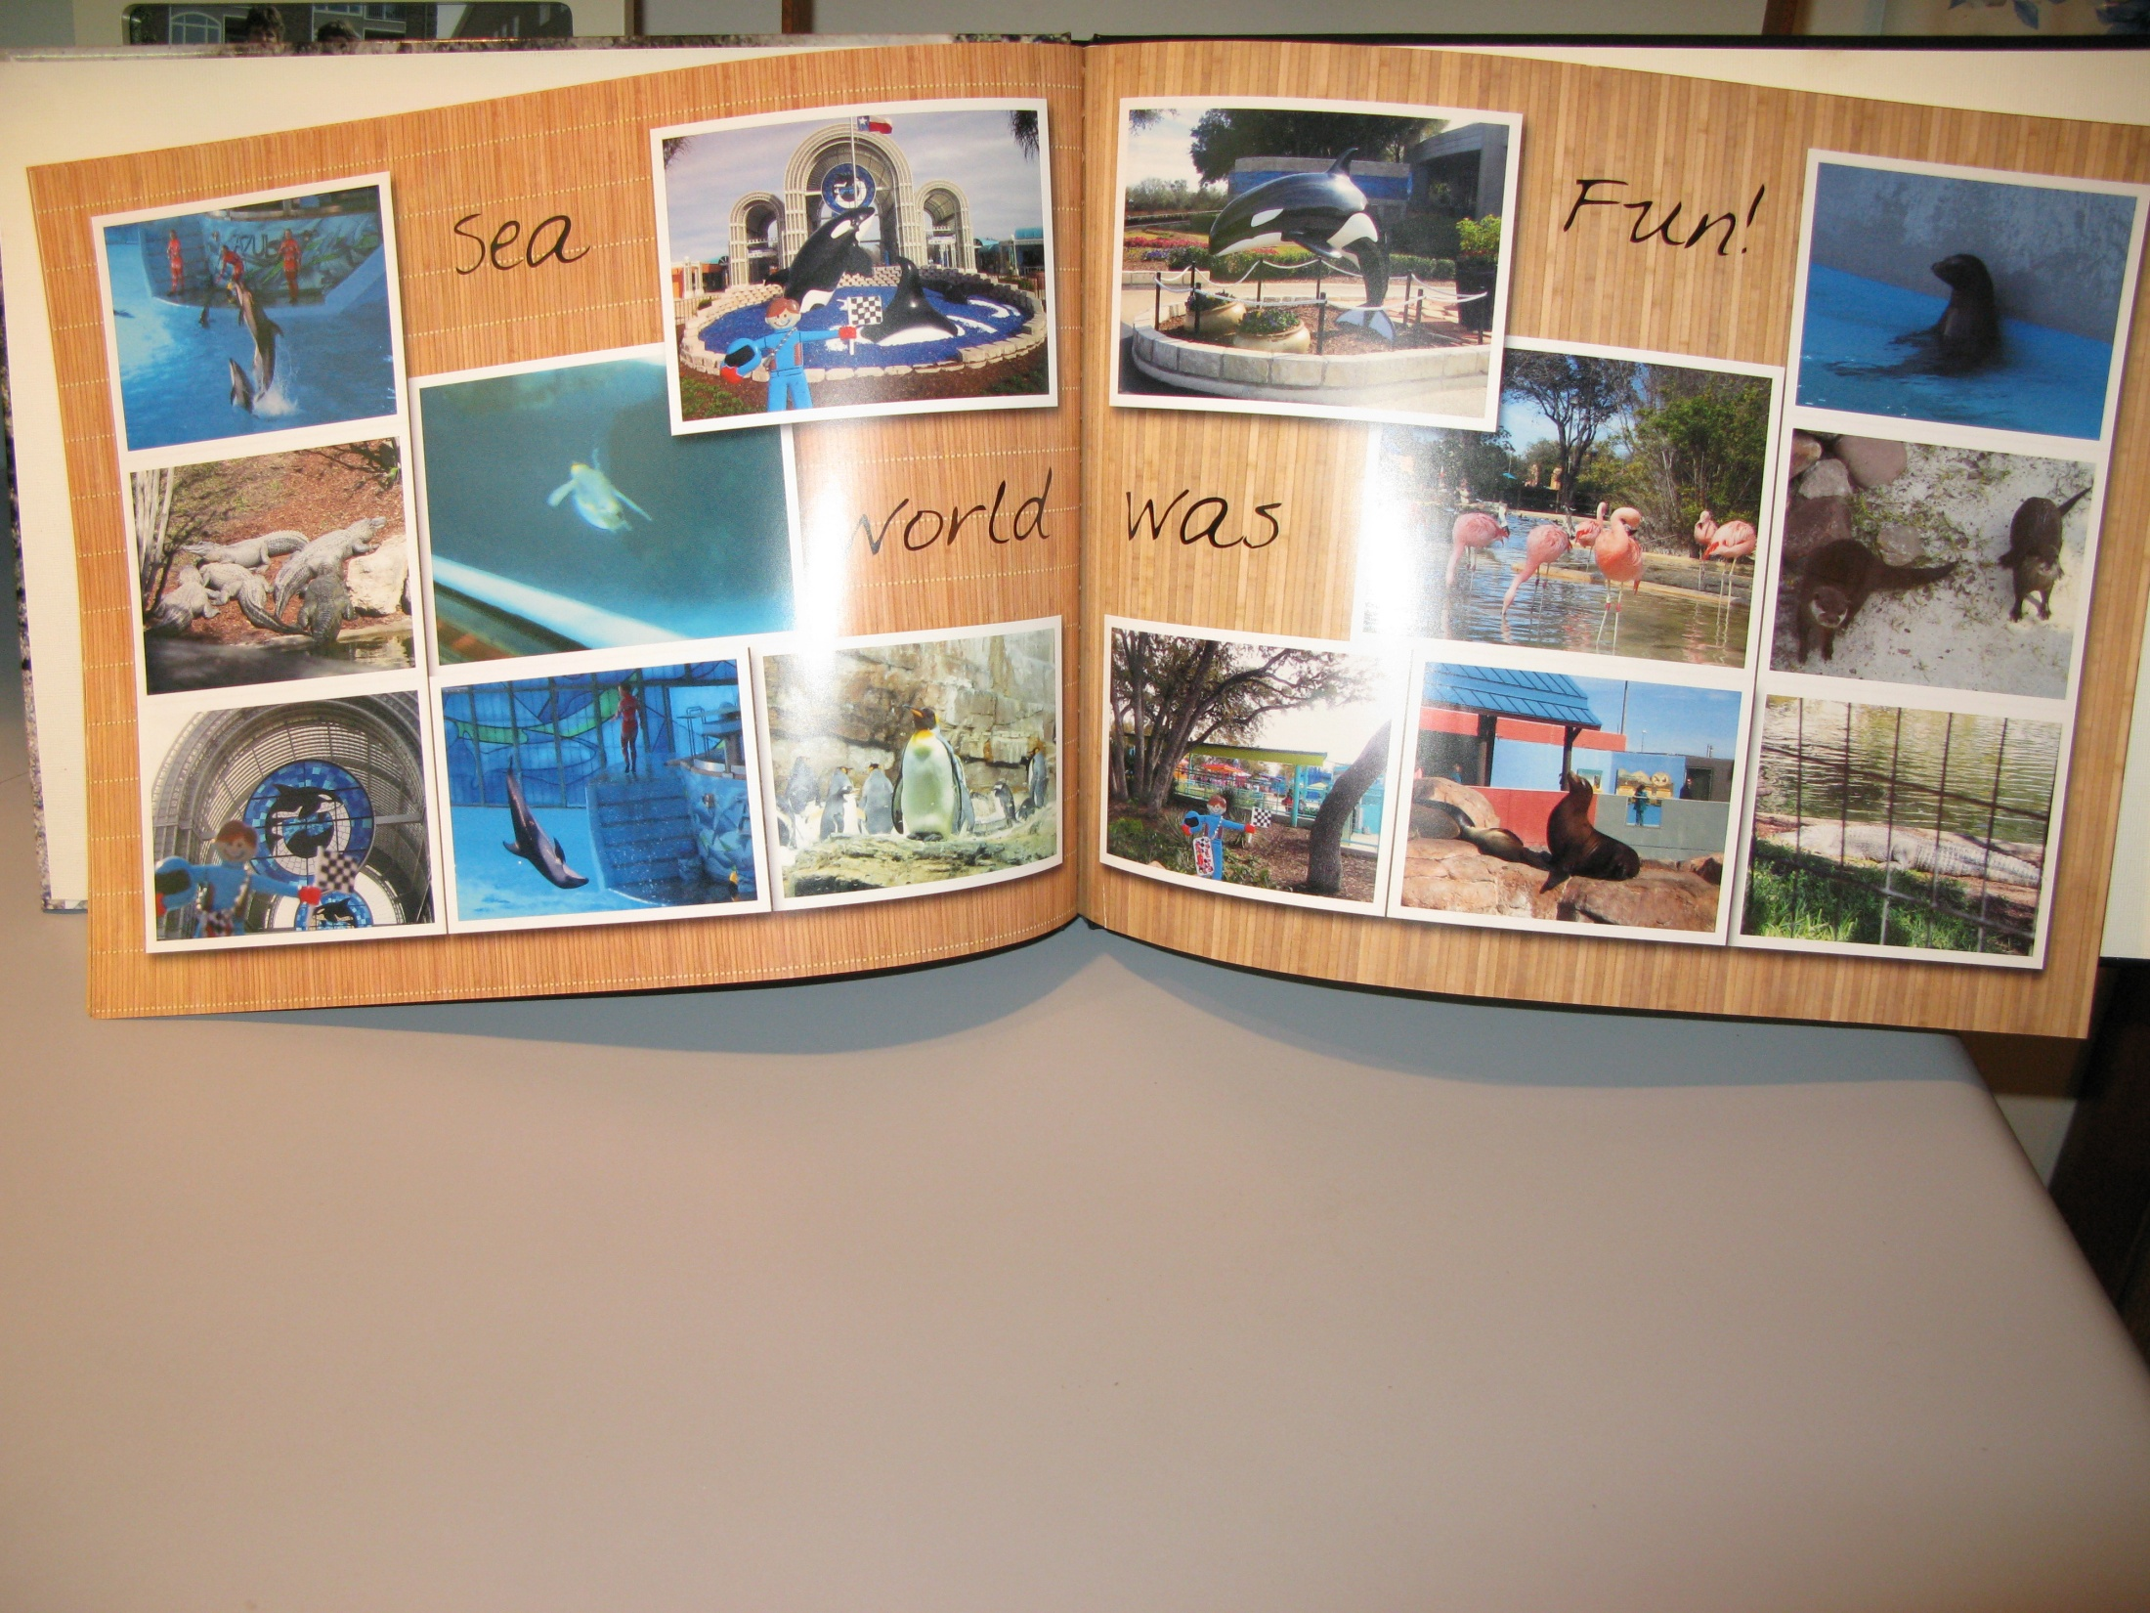

Slide 10
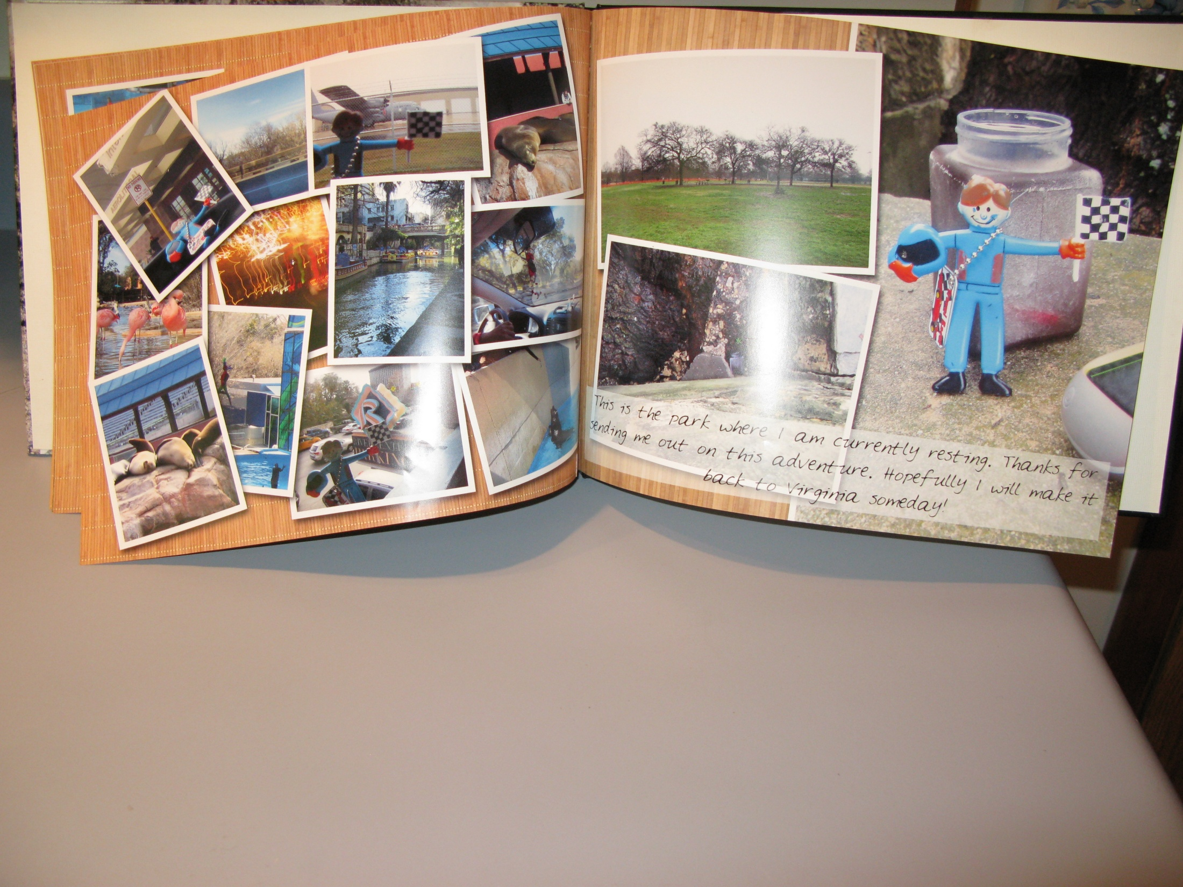

Slide 11
