Slide 1
The history of benches
By
Mason Hamlett

Slide 2
The benches were first made for the common people. Chairs were made for the more important people.

Slide 3
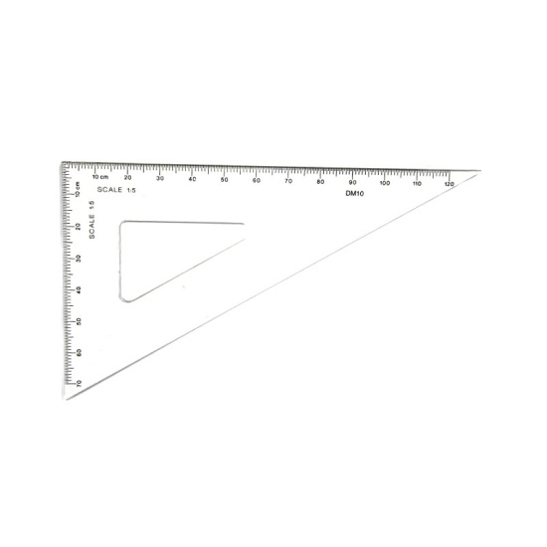
Tools to use

Slide 4
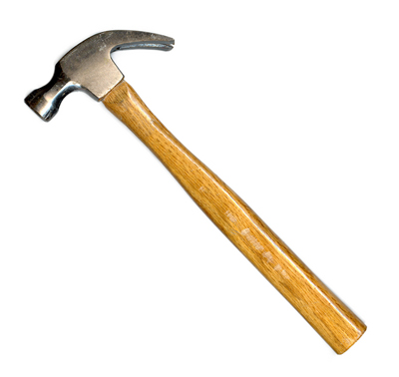
The tools to use

Slide 5
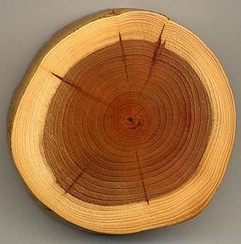
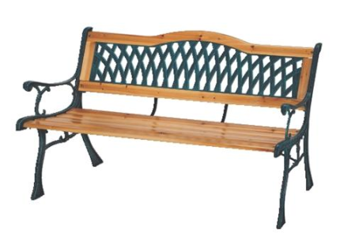
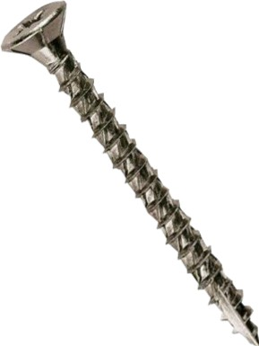
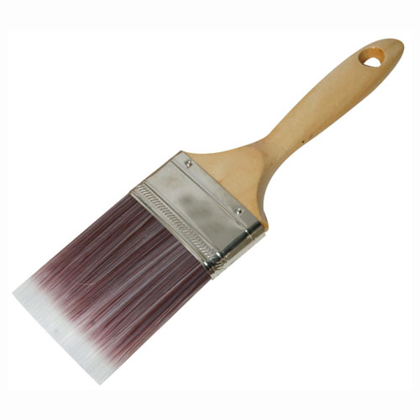
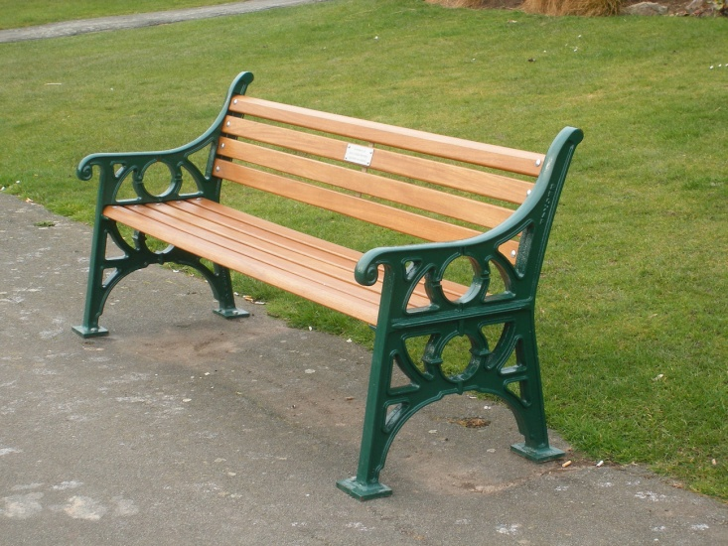
THE TOOLS TO USE

Slide 6
Benches are made of: wood stone metal synthetic materials

